Slide 1

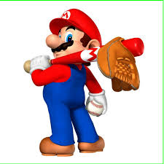
Baseball V
Produced by Dr. Mario | UNC STOR 390

Slide 2
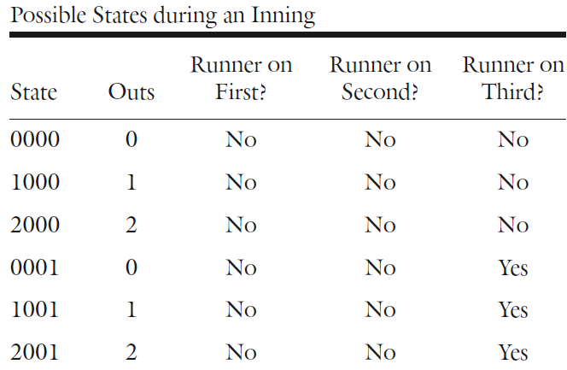
Baseball Decision-Making
Manager Decisions
Situation 1: Man on First and No Outs. Should We Bunt?
Situation 2: Man on First and One Out. Should We Steal?
Most Decisions in Baseball are Trade-Offs
All Decisions Have the Probability of Error
States of Baseball
24 Unique States in an Inning
Represented by 4 Numbers
Best State = 0111
Worst State = 2000
$$E\left[Runs | 0111\right]=2.27$$
$$E\left[Runs | 0111\right]=0.11$$

Slide 3
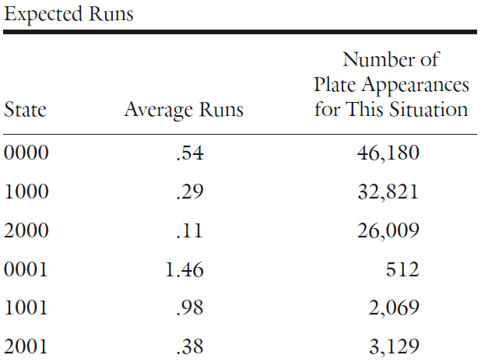
Baseball Decision-Making
States of Baseball
Average Number of Runs for Each State

Slide 4
Baseball Decision-Making
States of Baseball
Example: Pitching States of Plate Appearances
1 = Strike & 0 = Ball
Situation: Strike, Ball, Ball, Ball, Strike, Strike = 100011
States For Strikeouts
111
1011
1101
0111
11001
Etc.
States For Walks
0000
10000
01000
00010
110000
Etc.
States For Hits
1
0
10
01
00
Etc.

Slide 5
Baseball Decision-Making
Experiment
Any Situation where Outcome is Uncertain
Typically, Set of Outcomes (O) is Finite and Can Be Listed
Example: Pitcher Throws a Pitch
Random Variable
Associated with Experiments
Typically Involves Numeric Outcome Based on
Usually Notated with Capital Letter (X)
Sample Space (S) Represents Possible Values Involving Subsets of Set of Outcomes (O)
Example: X = Number of Balls in a Plate Appearance
$$O=\{Strike, Ball, Hits Batter,Hit in Play\}$$
$$S=\{0,1,2,3,4\}$$

Slide 6


Baseball Decision-Making
Expected Value
Average Value of a Random Variable if Experiment Repeated Infinite Number of Times
Formula for Expected Value
Example: X = Number of Balls in Plate Appearance
Formula Based on Law of Conditional Expectations
$$E[X]=\sum_{x∈S}{xP(X=x)}$$
$$E\left[X\right]=0×0.2+1×0.4+2×0.3+3×0.05+4×0.05=1.35$$
x | P(X=x)
0 | 0.2
1 | 0.4
2 | 0.3
3 | 0.05
4 | 0.05
$$E[X]=\sum_{y∈S}{E[X|Y=y]P(Y=y)}$$

Slide 7
Baseball Decision-Making
Expected Value
Example:
X = Number of Balls in a Plate Appearance
Y = First Pitch is a Strike (Yes = 1 & No = 0)
Average of 0.99 Balls When First Pitch is a Strike
Average of 1.83 Balls When First Pitch is a Ball
$$E\left[X\right]=1.83×0.43+0.99×0.57=1.35$$
y | E[X|Y=y] | P(Y=y)
0 | 1.83 | 0.43
1 | 0.99 | 0.57

Slide 8
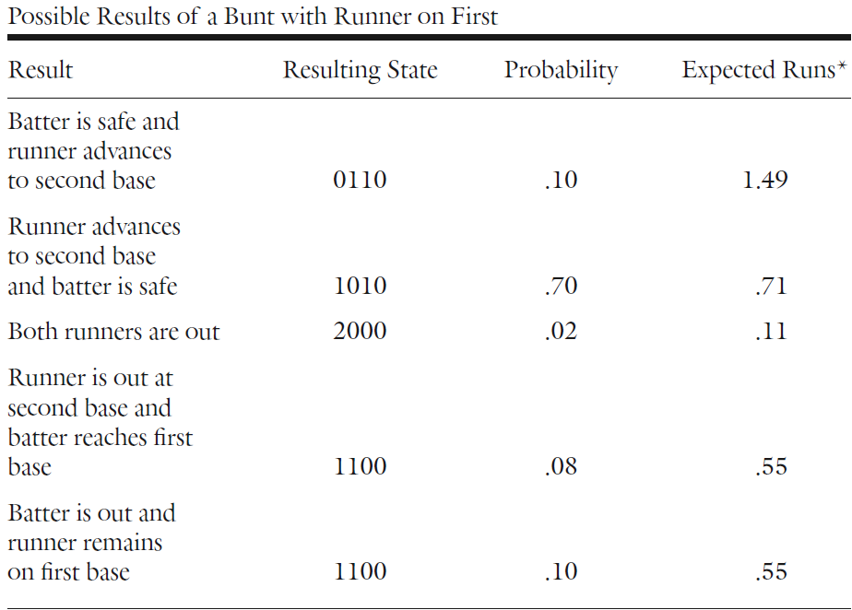
Baseball Decision-Making
Should We Bunt with Man on First and No Outs?
Expect 0.93 Runs Under Current State = 0100
List of Possible Resulting States With Probabilities
Based on Previous Table
Based on Known Relative Frequencies

Slide 9

Baseball Decision-Making
Should We Bunt with Man on First and No Outs?
Expected Number of Runs Scored After Bunt (X)
Comparing Expected Runs Without Bunt Versus After Bunt
Under Current State = 0.93 Runs
After Bunt = 0.75 Runs (Clearly Worse)
All of This is Based on the Average Hitter
What if I am Batting? Should I Bunt?
Strike Out 85% of the Time
Single 10% of the Time
Walk 5% of the Time
Suppose Stupid Manager Lets Swing for the Fence
$$E\left[X\right]=0.1×1.49+0.7×0.71+0.02×0.11$$
$$+ 0.08×0.55+0.1×0.55=0.75$$
$$E\left[X\right]=0.85×E\left[X | 1100\right]+0.1×E\left[X | 0101\right]+0.05×E=\left[X | 0110\right]=0.73$$
Assume Runner Gets to Third

Slide 10



Baseball Decision-Making
Should We Steal if Man on First and No Outs?
Suppose I am on First Base…No
Suppose Usain Bolt is on First Base…Yes
Short Answer: Depends on How Fast the Runner Is?
Let p = Probability of a Successful Steal
Expect 0.93 Runs Under Current State = 0100
Success: State = 0010 with 1.17 Expected Runs
Failure: State = 1000 with 0.29 Expected Runs
Based on Law of Conditional Expectations for
Expected Runs After Steal
When do We Want to Steal?
$$E\left[X\right]=p×1.17+\left(1−p\right)×0.29$$
$$p×1.17+\left(1−p\right)×0.29>0.93$$
$$1.17p+0.29−0.29p>0.93$$
$$0.88p+0.29>0.93$$
$$p>\frac{0.93−0.29}{0.88}=72.7\%$$

Slide 11

Baseball Decision-Making
Should We Steal if Man on First and No Outs?
Historically, 70% Chance of Success on Steals
Implies Bad Idea Based on Average Rate
Suppose Super Mario is on 1st Base with 95% Chance of Stealing
Marginal Increase:
Solution: Chill Out Super Mario
Conservative Versus Liberal Base Running
Expected 0.93 Runs in State = 0100
Single Gets Hit and Runner Is Faced With Two Choices
Scenario 1: Attempt to Get to 3rd Base
Scenario 2: Stop at 2nd Base
$$E\left[X\right]=0.95×1.17+\left(1−0.95\right)×0.29=1.126$$
$$1.126−0.93=+0.196 Runs$$

Slide 12

Baseball Decision-Making
Conservative Versus Liberal Base Running
Under Scenario 1: Expect 1.86 Runs in State = 0101
Under Scenario 2: Expect 1.49 Runs in State = 0110
If Runner is Out: Expect 0.55 Runs in State = 1100
Let p = Probability Base Runner Gets to 3rd Base
If p = 0.72, then…
Interpretation: If Base Runner has a 72% Chance of Getting to 3rd Base, the Expected Number of Runs Under the Attempt “Breaks Even” with the Expected Number of Runs of Being a Coward
Historically, 97% of the Time Base Runner Succeeds
Only Thing That’s on My Mind, is Who’s Gonna Run This Town Tonight
$$p×1.86+\left(1−p\right)×0.55=1.49$$

Slide 13
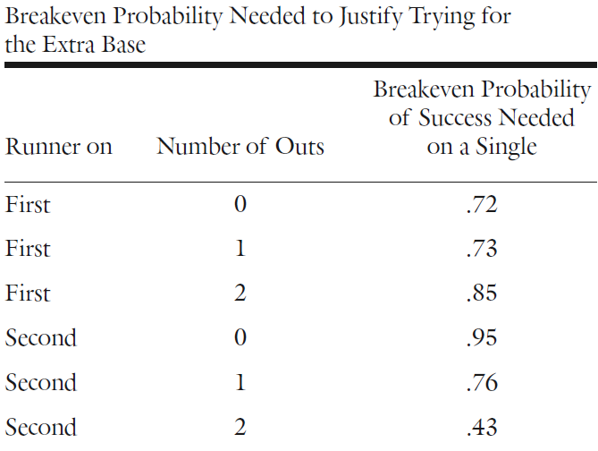
Baseball Decision-Making
Conservative Versus Liberal Base Running

Slide 14

Final Inspiration
If you are scared of a new situation, then lean in; you may just get hit by a pitch.
-Mahatma Mario

